Slide 1
Parent Meeting
CLHS Speech & Debate, 2023-2024
Find us on the web! clearlakedebate.org or twitter.com/clhsdebate

Slide 2
About Mr. Nassif
Graduated from Deer Park HS in 2005
Graduated from the University of Texas in 2009, B.A. in History with a minor in Secondary Education. Earned a Masters of Education in Curriculum & Instruction in December of 2017. Currently a doctoral candidate in educational leadership at UHCL.
Taught for two years at Deer Park HS (world history and speech & debate)
Two years in the private sector in communications
Eleventh year at Clear Lake HS

Slide 3
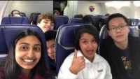

Slide 4
Why debate?
Boosts confidence
Scholarships
Intellectually challenging
Focuses on team as well as individual
Looks great on a college application
Most importantly… it’s fun!

Slide 5
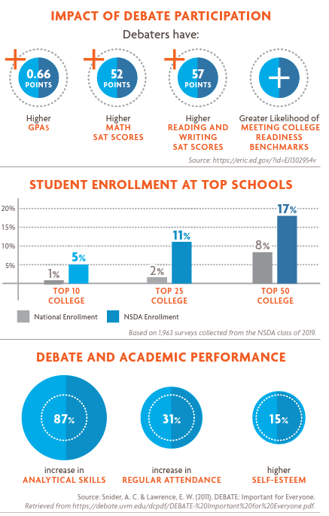

Slide 6
Student Expectations
The rules and expectations for members of the CLHS Speech & Debate team are outlined in two separate documents: the Constitution of the CLHS Chapter of the National Speech & Debate Association, and the CLHS Speech & Debate Parent/Student Handbook. You and your student both have already signed an agreement saying you have read and understood them and your student will follow them. Though it is important you and your student both truly read both fully, here are some particularly important notes:
Novice (first year) debaters are required to compete in 2 tournaments but are encouraged to participate in more. Advanced debaters are required to compete in 6 tournaments.
Almost all events occur both on Friday and Saturday, therefore attendance is mandatory for both days. Students may not leave early if they are no longer competing, as part of what I strive for is to foster a sense of team unity, and leaving early hurts that effort. Continually leaving tournaments early is grounds for suspension from the team.
All tournaments have a deadline past which any additions to the entry are forbidden and dropping out of the tournament can as much as double the cost. Any drop fees occurred are the responsibility of the student/parent, regardless of reason.
Per district policy, UIL No pass/No Play affects us as well.
In almost all circumstances, we travel as a team. That means on a big yellow bus.

Slide 7
Events
At any given tournament, students can compete in seventeen different events:
Debate
Cross-Examination Debate: a partner format of debate where two teams argue policy. Current topic looks at income redistribution in the United States.
Lincoln-Douglas Debate: a solo format of debate looking at philosophical and moral implications of a topic. Current topic is looking at a US federal guarantee of a right to housing.
Public Forum Debate: a partner format of debate designed to look at real-world implications of a current issue. Current topic is looking at the US military presence in the Arctic.
Congressional Debate: a solo format of debate where students compete in a room full of other students as a mock Congressperson.
Worlds School Debate: a team (3-5 person) format of debate with topics that vary from round to round.
Speech
Domestic/Foreign Extemporaneous Speaking: students have 30 minutes to prepare a speech on a topic seeking to answer a question about current events.
Impromptu Speaking: students have 7 minutes to plan and deliver a speech on a variety of topics.
Original Oratory/Informative Speaking: students research, write, memorize, and deliver a 10 minute speech over a topic of their choosing.
Prose/Poetry Interpretation: students perform a work of prose or poetry, making it come to life with their performance.
Acting
Duet Acting/Duo Interpretation: two students memorize and perform a work of literature
Humorous/Dramatic Interpretation: a single student memorizes and performs a work of literature
Program of Oral Interpretation: a single student synthesizes a variety of works of literature of different genres to create an original performance.

Slide 8
What have I gotten in to?
Competitive Speech & Debate is a LOT of work both in and out of class.
Practices every Tuesday and Thursday after school – advanced debaters and officers are required to attend a certain number, all others (especially those competing that weekend) are strongly encouraged. We also have practices during Falcon Lunch on Wednesdays as an optional practice.
In-class, time is split between preparing for tournaments and learning new or mastering old concepts
All of this work is to prepare for tournaments, held throughout the yearly mostly on Fridays and Saturday
Typically depart CLHS sometime in the very early afternoon to head, via bus, to another high school in the greater Houston area.
Competing, with few breaks, from mid-afternoon until well into the late evening.
Typically return to CLHS 10p-midnight Friday
Depart CLHS early Saturday morning (6a-7a), returning after all competitors are done with competition, can vary from 6p-11p.
Two VERY long days!

Slide 9
Speech & Debate is also extremely expensive, but what does that money go to?
Here is a typical example from a tournament where twenty-three students competed.
Our entry fees totaled $1060.00
Est. cost for bus/driver totaled $200.00
$1260.00 divided between 23 students comes out to around $55/student
Additionally, these are certainly not the only expenses we accrue. We also have state and national organization dues, materials such as copies or scripts, and many other expenses. Further, most students compete in more than the required six tournaments (for advanced debate). A team like ours, similar in competitive nature and size, can expect to have expenses anywhere from $20,000-$40,000.

Slide 10
How do we raise money?
Some of our budget comes from the required course fee each student is responsible for. The Debate 1 course fee is $100 while the course fee for the other debate classes is $200. This fee can be paid online via Skyward Family Access or in person with our bookkeeper. However, fees have not been rolled out yet so please wait for more information from me before attempting to pay. If there is a concern about payment, please let me know.
Our biggest (and hopefully sole) fundraiser is the tournament that we host every year. Given this, it is an incredibly important endeavor and requires an “all hands on deck” attitude. Last time we hosted here on campus, 35 schools brought 400 students and we made around $10,000. To make that happen required over 100 volunteer judges as well as parents assisting in the hospitality room and concession stand.
This year, we’re hoping to do at least the same – maybe even more. The tournament this year will be the first weekend of December, 12/1 and 12/2.
Every debater will have a job assigned to them; most jobs for Debate 1 students will be one day or one shift only.
Every debater will also be required to fulfill six judging slots, each slot lasting for between 1-2 hours. That can be six judges judging once, one judge judging six times, two judges judging three times, etc. A judge simply must be someone that has graduated high school, no prior experience or training required!

